Slide 1
Computer Science
University of Bristol
Samuel Russell – Dr. Carl Henrik Ek

Slide 2
What is computer science?

Slide 3
What is a computer?

Slide 4
What is a computer?
PC
Laptop
Phone
TV
Microwave

Slide 5
What is a computer?
“A computer is a device that can be instructed to carry out an arbitrary set of arithmetic or logical operations automatically.”
“one who calculates“
wikipedia
Notes:
A computer is anything that thinks, even people

Slide 6
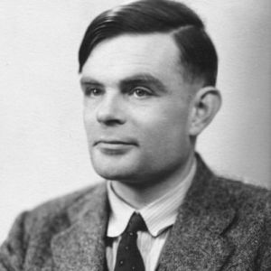
Prof. Turing
Computation
Halting problem
Notes:
Abstract thinking
What are computers bad at
What can computers never do

Slide 7
Practice
We care about the answer!
Notes:
It is very applied

Slide 8
Hardware
Electronic computers
Very stupid
A bit of maths

Slide 9

Binary
Notes:
Intro to binary
We use base 10 because we have 10 fingers

Slide 10
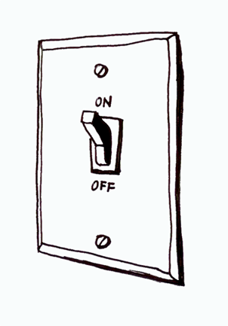
Binary
Notes:
Computers have light switched

Slide 11
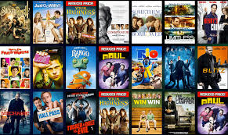

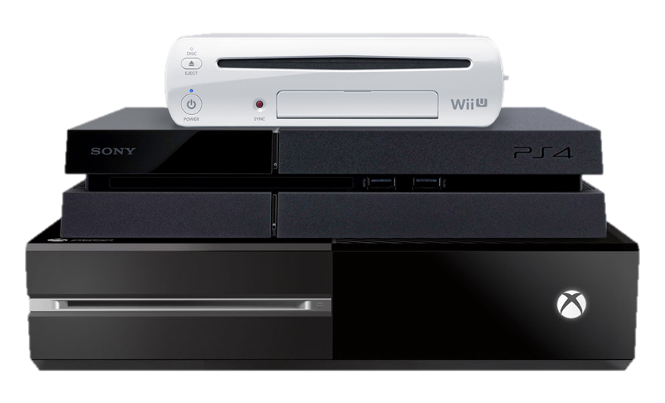
Everything is 0s and 1s
Notes:
Everything inside a computer is numbers

Slide 12
Binary Numbers
7,543₁₀
=
3 units, 4 tens, 5 hundreds, 7 thousands
=
3 x 1 + 4 x 10 + 5 x 100 + 7 x 1000
=
3 x 10⁰ + 4 x 10¹ + 5 x 10² + 7 x 10³
= 1110101110111₂
1101₂
=
1 x 1 + 0 x 2 + 1 x 4 + 1 x 8
=
1 x 2⁰ + 0 x 2¹ + 1 x 2² + 1 x 2³
Notes:
Work through example

Slide 13
Taking a look at the Big Hex Machine

Slide 14
What is computer science?
Notes:
I never answered the question

Slide 15

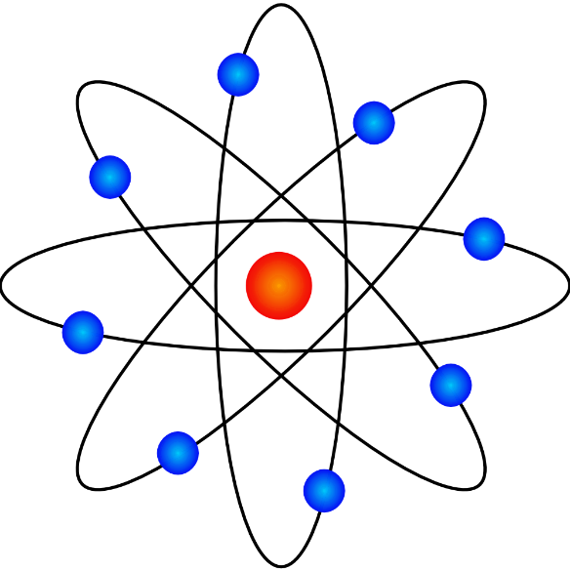


What does a computer scientist do?
Notes:
Examples:
Animal behaviour models
Game designing
Science Simulations

Slide 16
Computer science: the discipline
Theory of solving abstract problems
Traveling salesman problem
Cryptography
Hardware design
Computer chips
Programming
Solve real world problems
Or just to entertain people

Slide 17
Hands on time.
BBC Micro:bit
Space Invaders
[Worksheet] / [tinyurl.com/microbitbristol]
BigHexMachine Simulator
[tinyurl.com/bighexmachine]

Slide 18


Slide 19
